Slide 1
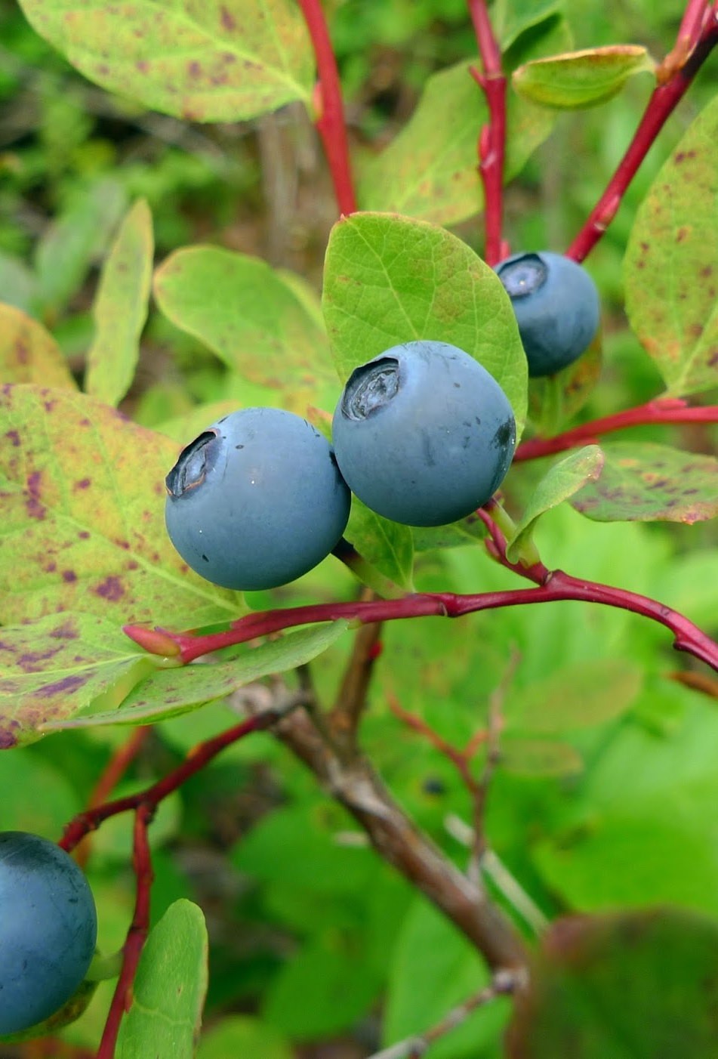


Blueberry Care February 21, 2026

Slide 2
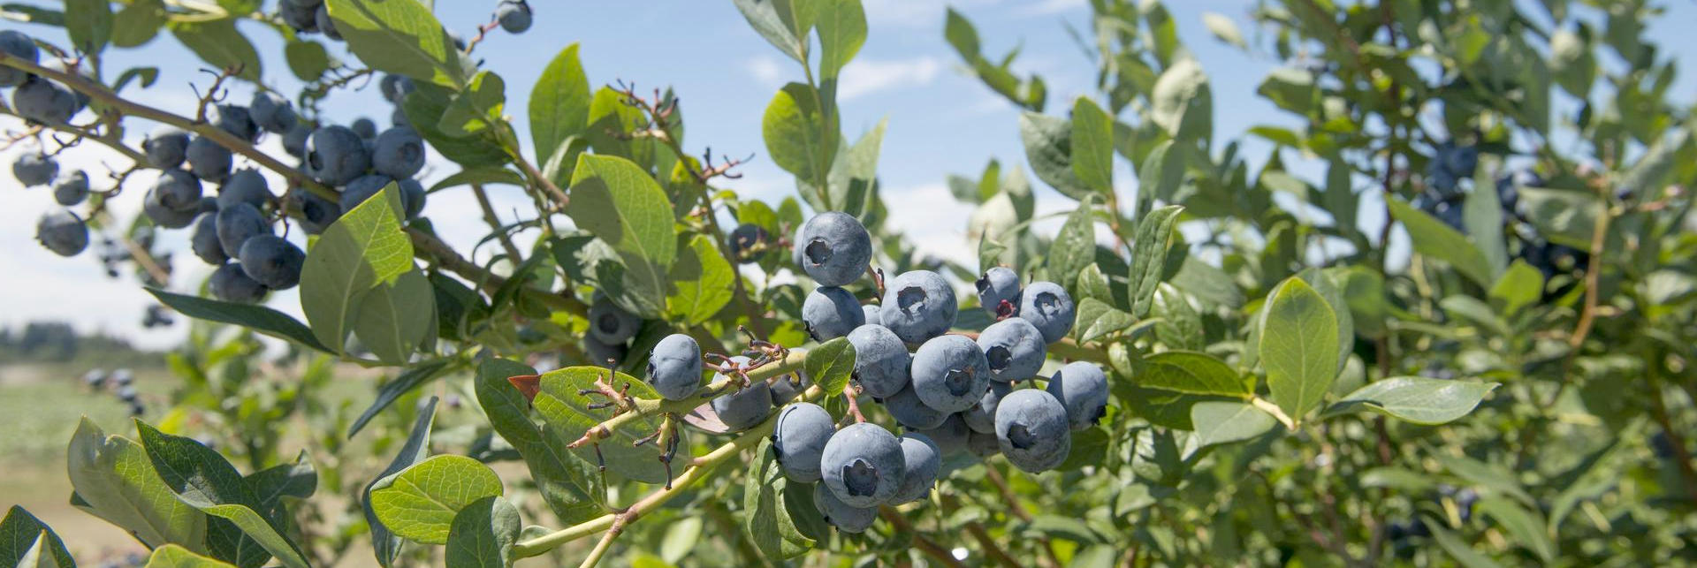
Photo: Lynn Ketchum
OSU Extension Master Gardener Volunteers:
Lisa Barnhart
Helen Dorbolo
Stephanie Engle
Sue Ryburn

Slide 3

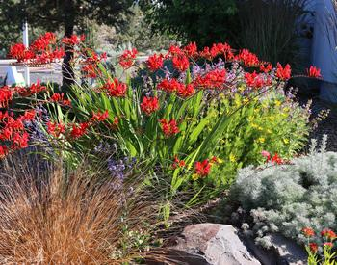

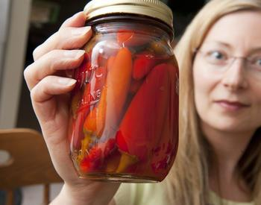
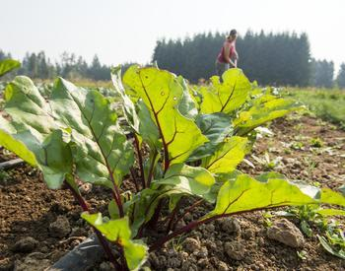
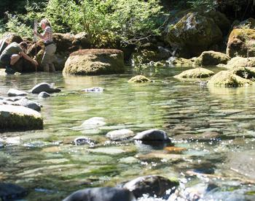
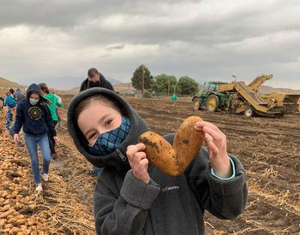

OSU Extension provides information and expertise to help meet local challenges and help every Oregonian thrive.
Open Campus
4-H Youth Development
Sustainable agriculture and gardening
Family and Community Health
Forestry and Natural Resources
Aquatic Health
Small Farms
Farm to School and School Gardens
https://extension.oregonstate.edu/washington

Slide 4
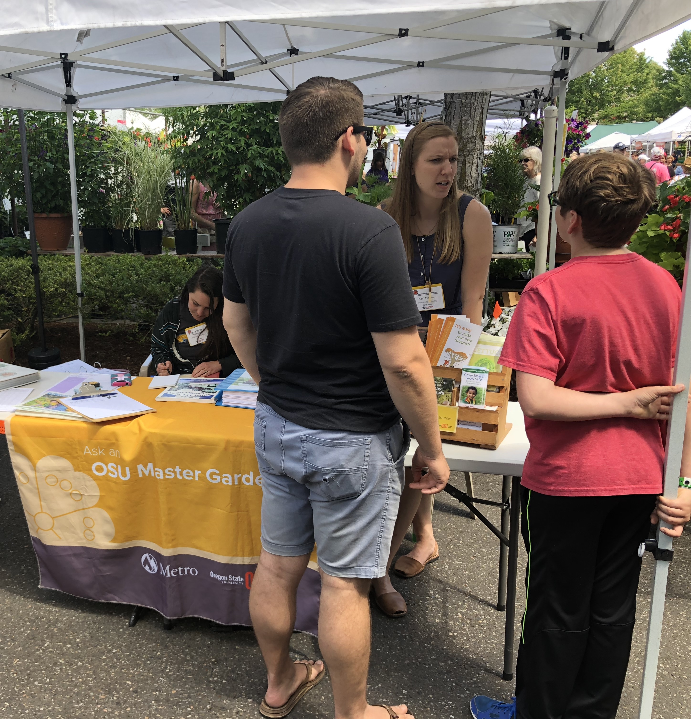
OSU Extension Master Gardener Program
Helps Oregonians grow healthy gardens​
Provides gardening information rooted in science
More than 3,000 trained volunteers provide 200,000 volunteer hours and 250,000 contacts annually​
Requires annual volunteer recertification

Slide 5
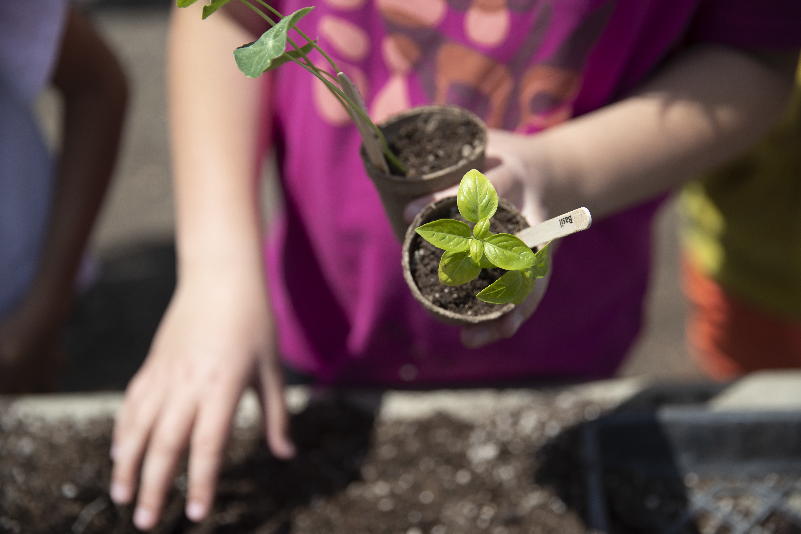
OSU Extension Service and Master Gardener Associations Events Calendar
Find upcoming events at:
-Free events and webinars, all welcome!
-Register for some in advance
www.metromastergardeners.org
Photo credit: OSU Extension Service

Slide 6
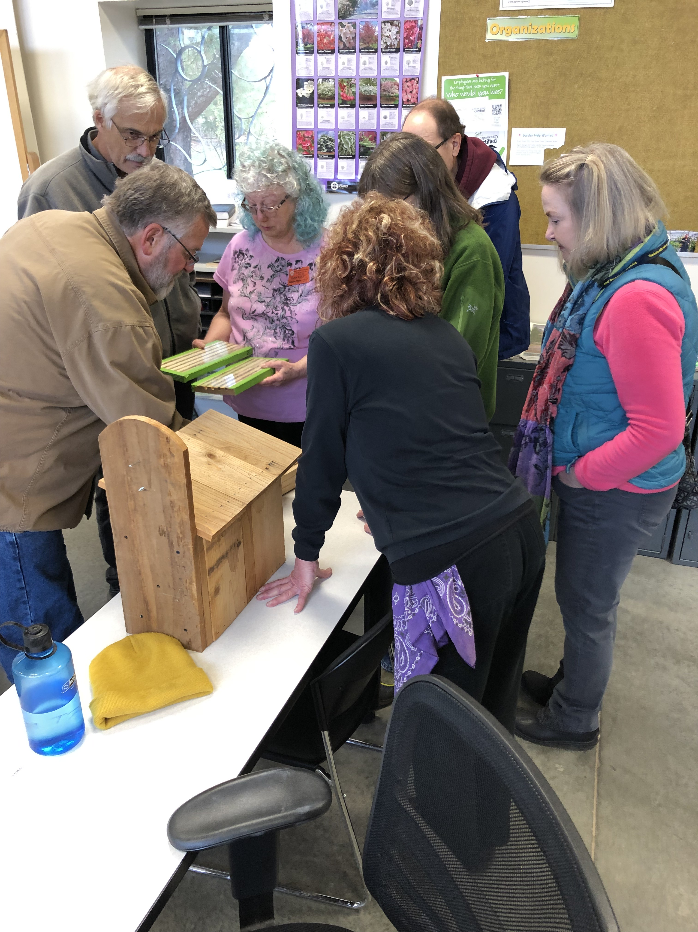

Washington County Master Gardener Association
Works in support of and in collaboration with the OSU Extension Service Master Gardener Program
Volunteers to educate the public about sustainable and affordable gardening by providing relevant, research-based education
For information about WCMGA free educational events see our website :
www.washingtoncountymastergardeners.org
Notes:
Many at our gardens which are sited

Slide 7
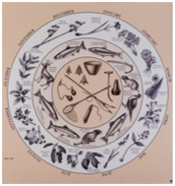
Land Acknowledgement
The Washington County Master Gardener Association acknowledges that the land occupied by our gardens rests on the ancestral lands of the Tualatin band of Kalapuyans, who once lived along the Tualatin River before the forced removal from their land prescribed by the Willamette Valley Treaty of 1855.​
Members of The Confederated Tribes of the Grand Ronde and The Confederated Tribes of Siletz, the Kalapuya people continue to be purposeful stewards of their land by design. They managed a seasonal fire and harvest regimen until the 1840’s and are currently involved in efforts to restore native habitat in the Willamette Valley. We seek to educate ourselves about their lifeways and collaborate with them using both traditional and scientific gardening methods.​
We further express our gratitude to their descendants for carrying on the traditions and culture of their ancestors. We invite everyone to appreciate and reflect on the resilience and healing power of the land and community of their ancestors.​

Slide 8
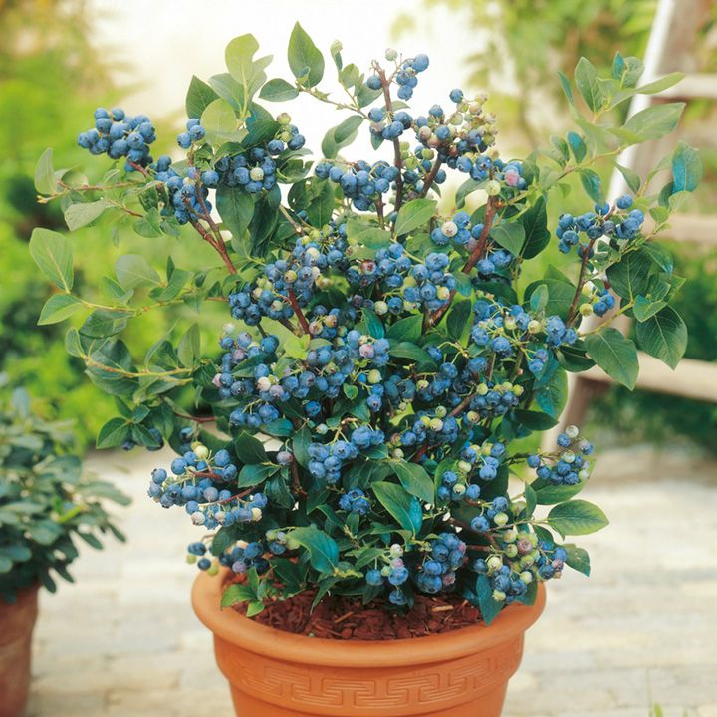
Blueberry Care Topics
Soil Management
Varieties for our area- Willamette Valley:
Northern highbush (6’-7’ ht)
Half High (hybrid northern highbush & lowbush 2’-4’ ht)
Rabbiteye (9’ ht–needs two cultivars to cross-pollinate)
Fertilizing and adjusting pH
Pruning
Pruning Video
Hands On Pruning in the PCC-RC Learning Garden
Resources Listing and Powerpoint at WCMGA website (post by Monday)
Notes:
Notice the blueberry in the container.

Slide 9
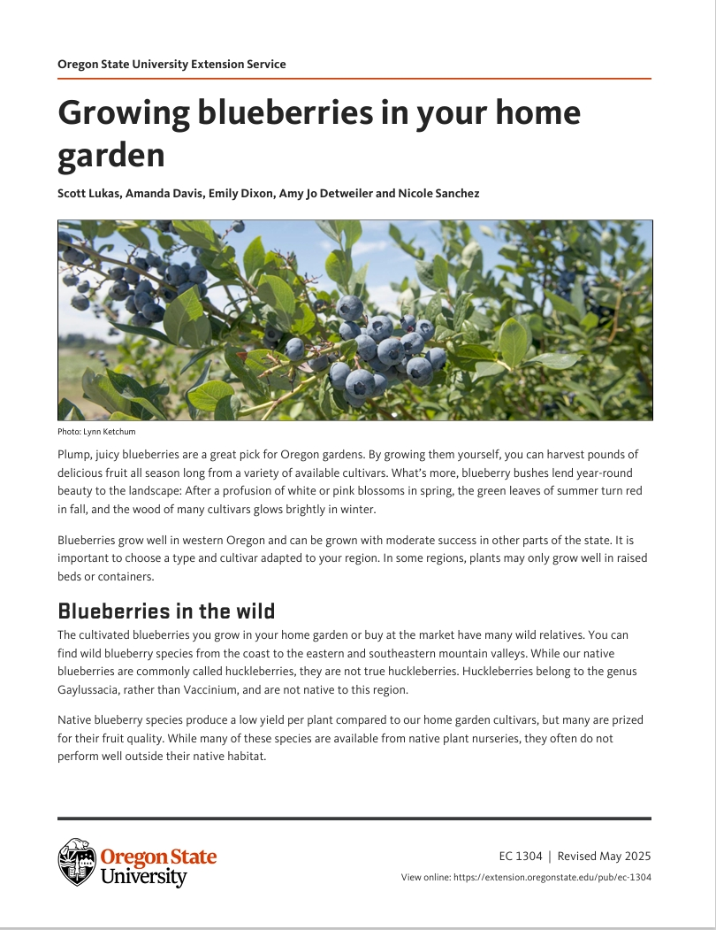
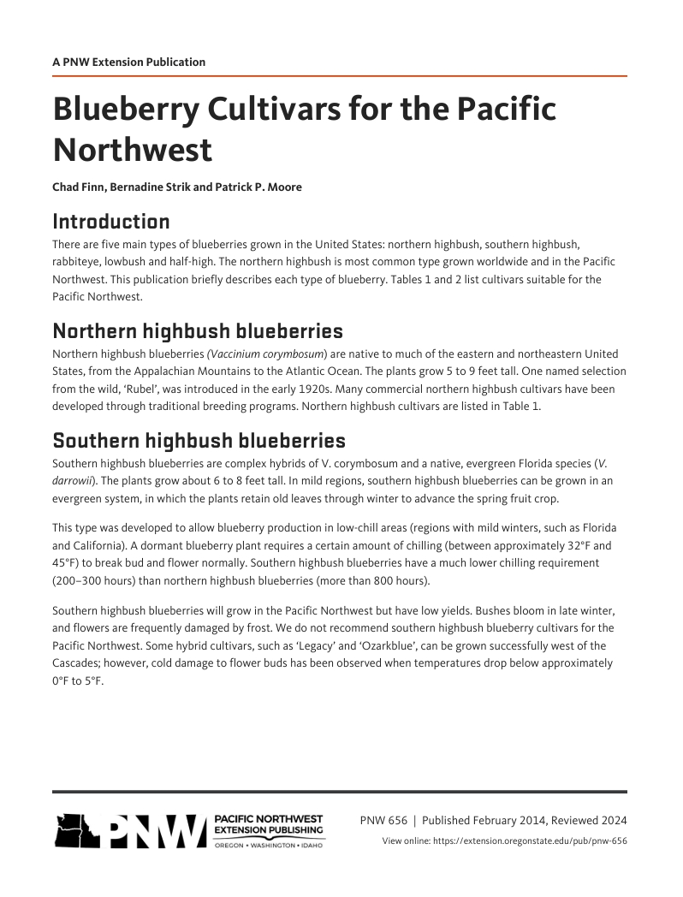
Growing Blueberries: Home Gardener Must Have Resources! OSU Extension Knowledge Base https://extension.oregonstate.edu/topics

Slide 10
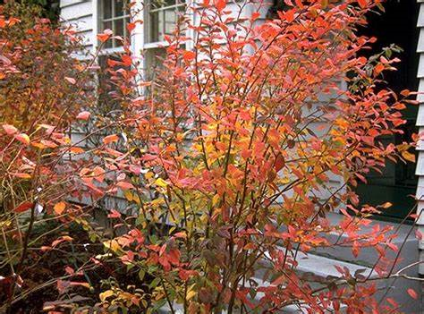
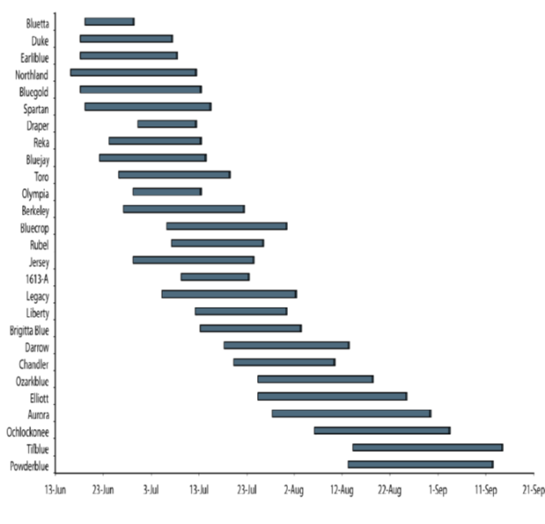
Fruiting Season for Blueberry Varieties
(Source OSU Publication PNW 656 Blueberry Cultivars for the Pacific Northwest)
Pick varieties you like-Blueberries can bear fruit up to 50 years!
See OSU Pub Blueberry Cultivars for the PNW
Plant two blueberry cultivars of the same type, to improve production.
Check out Farmers Market to try different varieties
Grow several varieties to extend growing season

Slide 11
Blueberry varieties (Source OSU Publication PNW 656 Blueberry Cultivars for the Pacific Northwest)
 | Cultivar | Bush | Berry | Yield | Large-scale commercial value | Small farm or home garden
 | Bluetta | Moderate vigor, compact, | Medium size, light blue, firm, poor scar, good | Low to medium | 3
 |  | consistently productive, more | flavor, loose clusters, not suited to shipping
 |  | frost- and winter-hardy than
 |  | Earliblue
 | Duke | Erect, open, susceptible to root | Large size, uniform, light blue, firm, small scar, | Medium to high | 1 | √
 |  | rot, performs poorly when soil | excellent eating quality, flavor declines less in | (but variable
 |  | pH and fertility not optimal. | storage than other cultivars, excellent shipping | with location and
 |  | Plant on well-drained soil and | quality, machine harvests well (including for | management)
 |  | manage irrigation well. | fresh market) with optimal management
 | Earliblue | Vigorous, erect | Medium to large size, light blue, firm, | Medium | 3 | √
 |  |  | resists cracking, medium scar, good flavor,
 |  |  | sweet, aromatic, medium-loose clusters,
 |  |  | ships well, fruit ripens early, ripe berries will
 |  |  | remain attached
 | Huron | Vigorous, erect, excellent winter | Moderately large size, small and dry picking | Medium | 2
 | (U.S. Plant | hardiness, late flowering among | scars, medium blue, excellent firmness and | (performs better | (yield and quality is
 | Patent 21,777) | early cultivars | superior flavor when fully ripen | with cross- | good for areas where
 |  |  |  | pollination) | other cultivars are not
 |  |  |  |  | cold hardy)
 | Bluegold | Vigorous but somewhat squat, | Large size, light blue, firm, small scar, very good | Medium to high | 2
 |  | very susceptible to Blueberry | flavor, overall excellent quality, often retains | (varies from field | (challenging bush
 |  | shock virus (which may stunt | stems when picked | to field and year | habit, variable
 |  | plants if infected when young) |  | to year) | performance)
 | Spartan | Vigorous, erect, open, generally | Very large size, light blue, moderately firm, very | Medium to high | 3 | √
 |  | does not do as well on | good scar, excellent flavor, blooms late (avoids
 |  | heavy soils | frost injury) but ripens early, concentrated
 |  |  | ripening permits two main pickings
Notes:
OSU Publication listing various types of blueberries, characteristics and use in the home garden.

Slide 12

For a deeper dive…

Slide 13
What do blueberries need to thrive?
Full sun, at a minimum 8 hours sunlight
Two varieties of the same type—better for cross pollination
Soil pH of ~ 4.5-5.5 acidic---Plant Blueberries together
Soil pH and nutrient uptake are interrelated
Regular water –rain or summer irrigation, moist soil at root zone
Well drained soil-create berm for heavy (clay) soil
Mulch
Fertilize routinely
Annual pruning to promote new growth, maximize yield
Patience –it will pay off !
Notes:
Select a site that meets the needs of the blueberry.

Slide 14
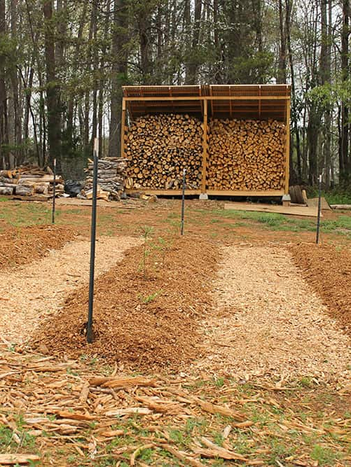
Site Prep
Select site—sun exposure, drainage, accessible, water source, away from tall trees
Soil Test-Tips: blueberries, home garden, pH, Organic Matter, nutrients, recommendations and graphical display. ~ Every 3 years.
Berm up area 12”-18” Ht X 3’ wide = root zone
Using soil test results, amend soil and wait 6-12 months
Mulch once planted

Slide 15
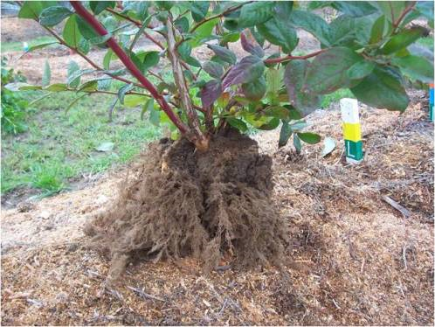
Planting Blueberries
Following site preparation….
Plant healthy 2‑year-old plants in March/April/October
Space plants 4’-5’ apart.
Plant where the root ball is actually located-too deep will smother plant
Water in
Cover with mulch 2 “ Douglas-fir sawdust/pine shavings/bark, pine needles, straw
Container plantings—Yes can do
Blueberry Root Ball—notice fibrous mat of roots

Slide 16
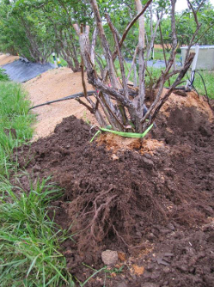
Transplanting a Blueberry
Prepare new site in advance
Transplant when dormant
Dig up blueberry protecting root ball
Plant in prepared planting hole that is ~ 1.5 x the width of the root ball
Set plant at a depth where planting hole top is level with root ball
Backfill with soil
Gently tamp down—no stomping!
Water In, Mulch
Follow by pruning during dormant period as normally. Then remove another ~ 20%-40% of remaining wood-allows plant to direct energy to establishing the plant and recovery.
From Pruning Blueberry for Quality, Growth and Yield OSU Ext e-Course

Slide 17
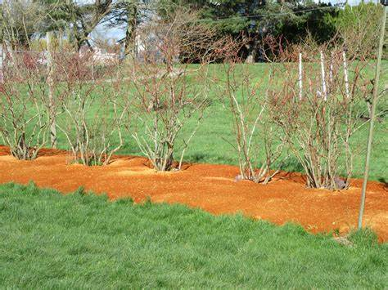
Mulching Blueberries
Reduces weeds, keeps roots cool, retains moisture, adds organic matter to soil over time, improves soil porosity
Breaks down at a rate ~ 1”/year in our area
Mulch is on top of soil, not turned into soil
Use pine, Doug fir shavings/saw dust, straw, pine needles
Avoid using compost as a mulch- tends to raise pH
Avoid using manure for mulch-too many salts
Avoid fresh cedar and redwood mulch- may injure young plants
No black walnut mulch-can be toxic to several plants
Year 1 of planting 2” inches
Year 2 after planting 4”
Year 3 after planting 6”
Year 4 and ongoing 6”

Slide 18

Nutrient Management
Use results from Soil Test for recommendations
Soil pH and nutrient uptake are interrelated
Managing Nitrogen (N) several options: new vs. established plants, sandy vs. clay soil:
Ammonium sulfate (not ammonium nitrate) N-P-K = 21-0-0
Feather meal , bloodmeal, cottonseed meal
Urea
Elemental sulphur
Time applications for optimal uptake by development phase of plant and type of fertilizer

Slide 19
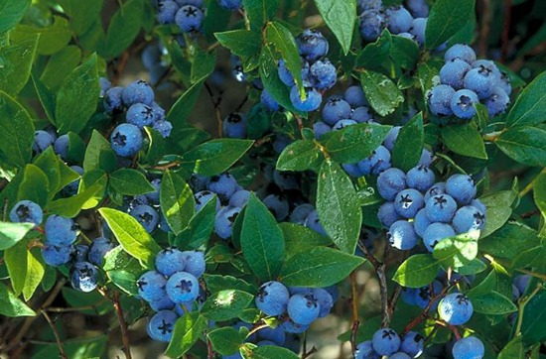
Blueberry Care Timetable (Source Growing Blueberries in Your Home Garden, OSU Extension Publication EC 1304)
Blueberry Care Timetable-after soil preparation in prior year—general recommendations | Year 1-planting | Year 2 | Year 3 | Year 4 | Ongoing
Mulch Doug-fir sawdust/chips/shaving/needles | 2 “ | 4” | 6” | 6” | 6”
Fertilizer Oz/Nitrogen/bush/year (See Growing Blueberries in Your Home Garden Nutrient Management p.13-17 for Northern Highbush and hybrid cultivars) | .4-.6 oz N | .6 -.7 oz N | .7-.9 oz N | .8 -1 oz. N | Yrs. 5-8+ Phase increase up to 1.5-2.1 oz
Water inches/week-to moisten root zone (Rain/Irrigation) | 1” | 1.5”-3” | 1.5”-3” | 1.5”-3” | 1.5”-3”
Fruiting Buds | Remove | Remove ~ half | Leave | Leave | Leave
Prune | Yes | Yes | Yes | Yes | Yes

Slide 20
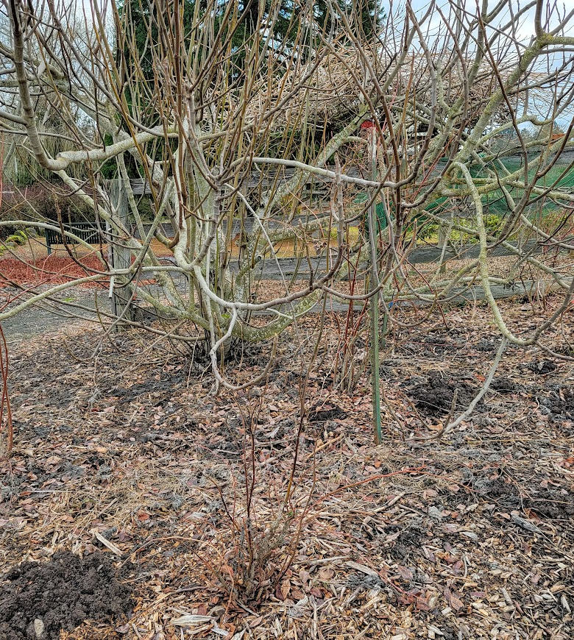
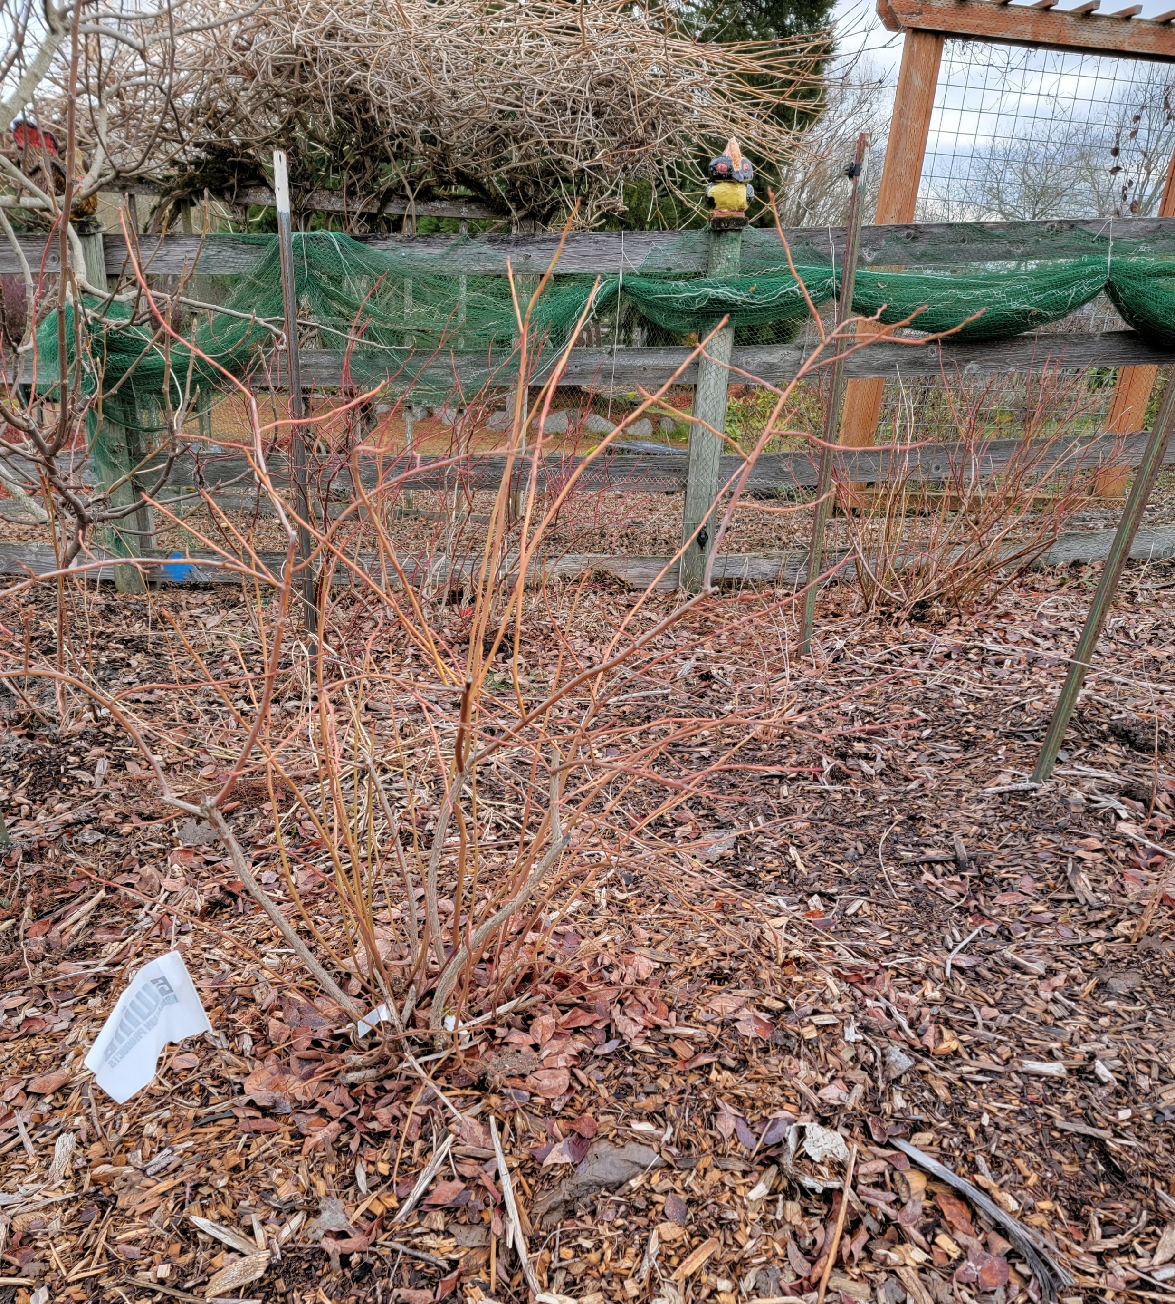
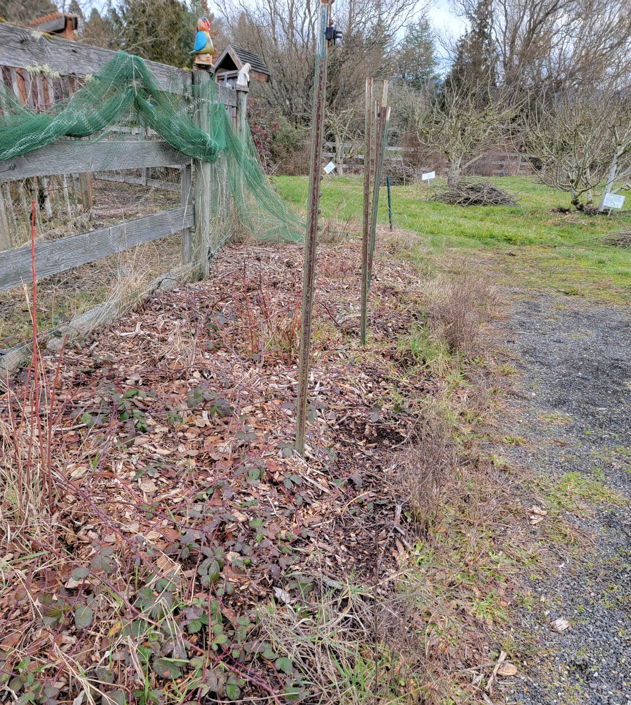
Other Care Needs - birdnetting, weed removal, site away from trees

Slide 21
Why prune and when to prune blueberries?
Prune established plants annually late winter/early spring before bud break (Jan-early March). Don’t prune after bud break and leafing-wait to next yr..
Removing some fruit potential, energy is directed to remaining fruit production.
Increases yield –bigger and earlier ripening fruit Creates better air flow and sun infiltration-reduces disease Haven’t pruned in many years ? …. For tips see Revitalize Blueberries with Renovation --Michigan State Univ. Ext.
https://www.canr.msu.edu/news/revitalize_blueberries_with_renovation
Notes:
If we miss being able to prune during Jan-early March one year, let it go—don’t try and prune but instead wait until next year.

Slide 22
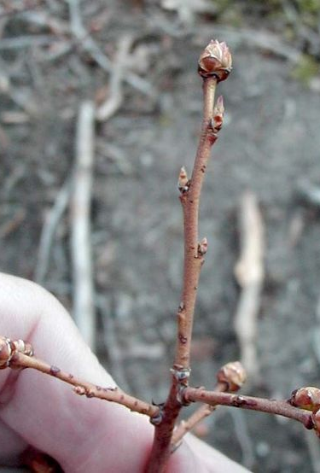
Flowering buds vs. vegetative buds
Samples of stems, flowering buds and vegetative buds.
A shoot at beginning of bud burst. Note the large, plump flower buds located at the ends of last year’s growth. Smaller leaf buds, located below the flower buds, are also growing and are at green tip.
The uppermost buds began growth first and are more developed.
Notice how each of the lower buds is less developed than the bud above it.
Two types of buds: flower buds and vegetative buds. The flower buds have only flowers in them that develop into fruit and the vegetative buds will only form leaves and shoots.
Flower buds are big, plump and easy to see, usually at and near shoot tips.
Vegetative buds are small, pointed, located further down the shoot.
Blueberry bush only has flowering buds on last year’s growth.
(Photo by Mark Longstroth, Michigan State Univ. Extension)

Slide 23
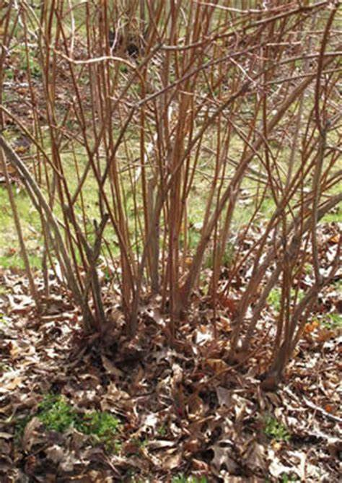
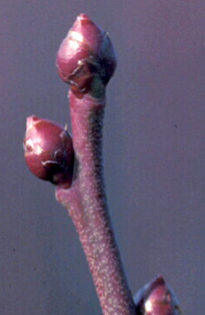
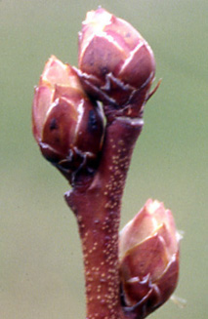
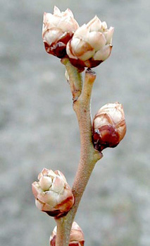
Video - Pruning Blueberry Bushes Univ. of Maine (6 minutes)
Blueberry Growth Stages https://www.canr.msu.edu/blueberries/growing_blueberries/growth-stages
Dormant/Tight Bud Bud Swell Bud Break/Burst

Slide 24
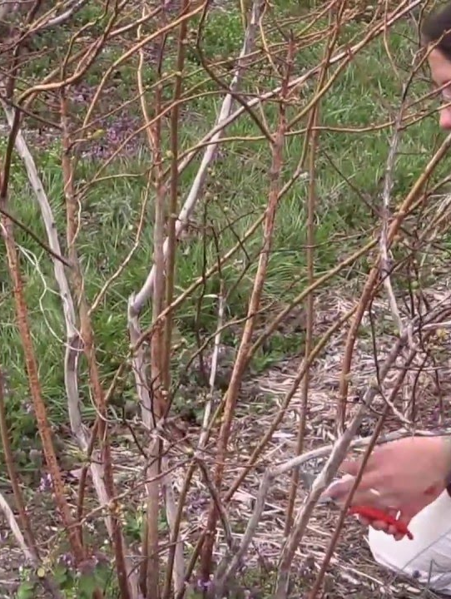
Steps to Prune-recap
Assess
Prune out dead, diseased, dying stems and canes
Remove some oldest canes—gray bark, thicker stem with fewer flower buds
Blueberry canes (branches) are most productive when canes are at 3- 6 years
Goal is to have 6-12 (depending) remaining canes after pruning
Retain strong whips for future growth
Remove canes that are low, touching ground now or will be when fruiting-avoid contamination.
Remove twiggy stems—they are low producing
Pruning results in fewer flowering buds, is a balance of new and old canes
Leave some of the newer canes- vigorous, shiny red stems coming from base for new production
It is ok to take more than 10 minutes, especially if you are learning.

Slide 25
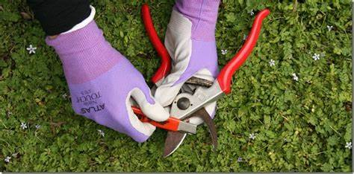
Wrap up in classroom, on to pruning in the garden…
Walk to PCC RC Learning Garden Blueberry bed
These Blueberries pruned past four years by MGs and this class
Form four small groups around white flags
Clean and sharpen pruners
MG Does Pruning Demonstration
Hands On Pruning by group
~ 11:50 AM Clean up stems
Please complete evaluations
Want more sustainable gardening information?
Notes:
Demo sharpening and cleaning pruners.
Use gloves.

Slide 26

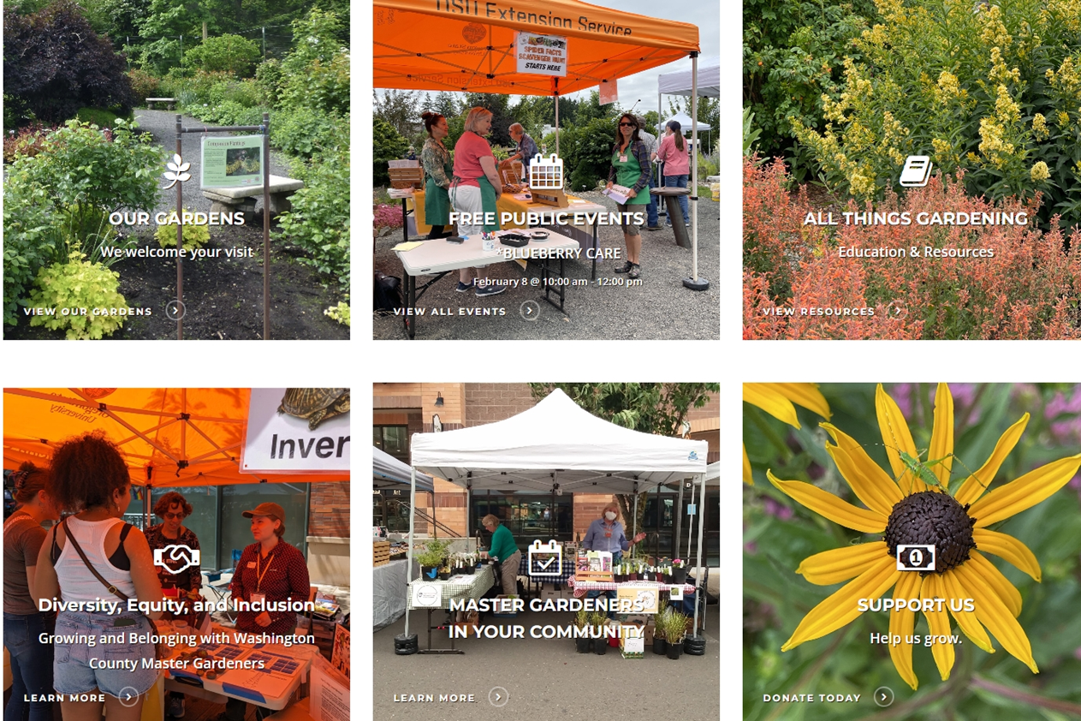

Washington County Master Gardener Association
www.washingtoncountymastergardeners.org

Slide 27
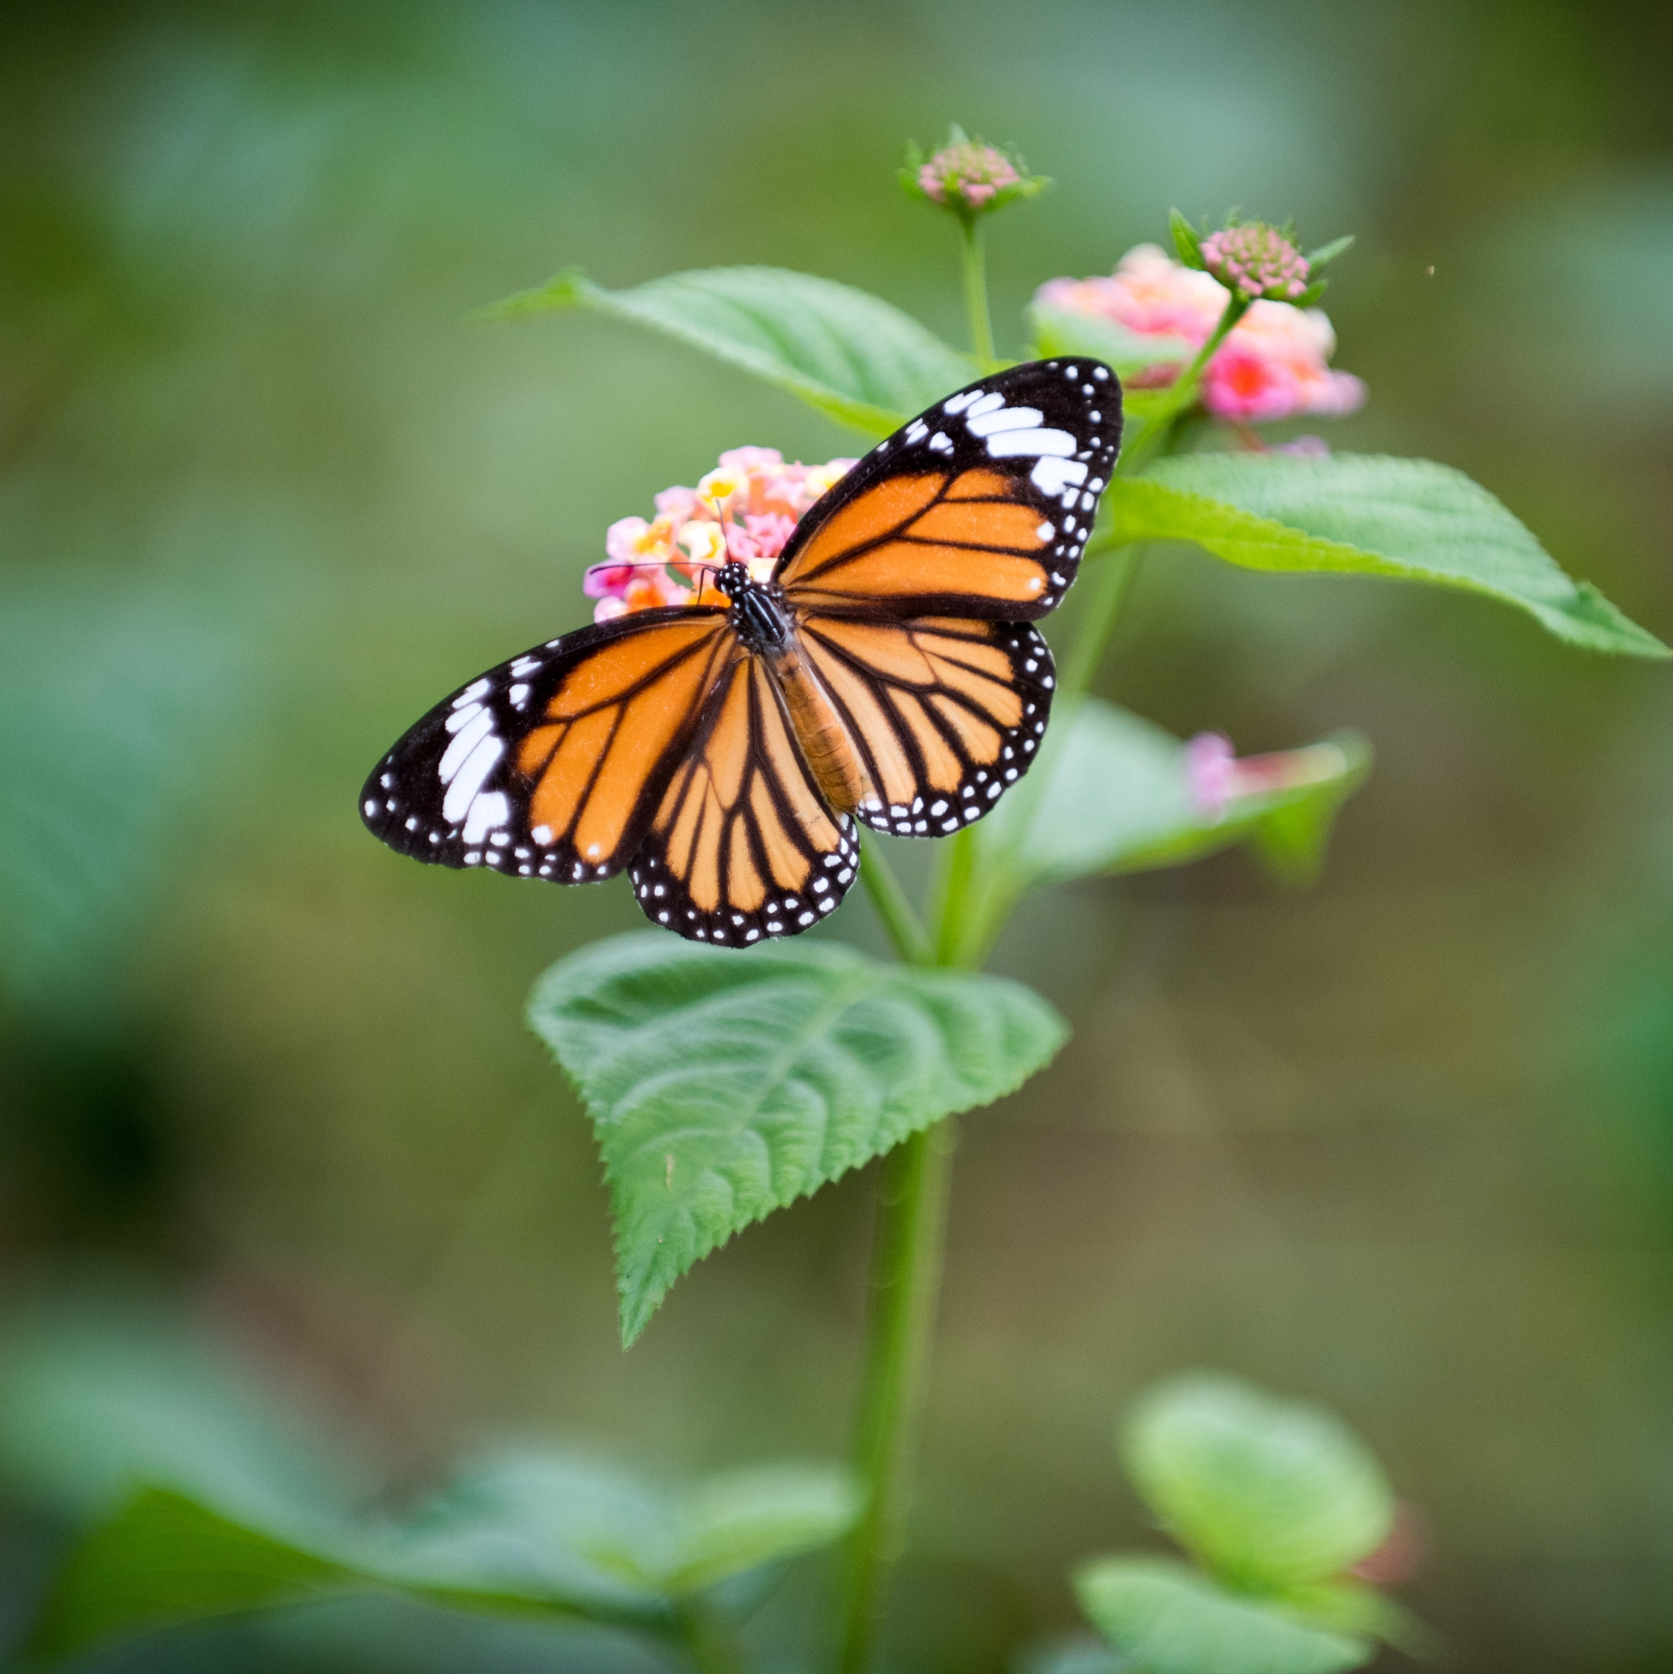
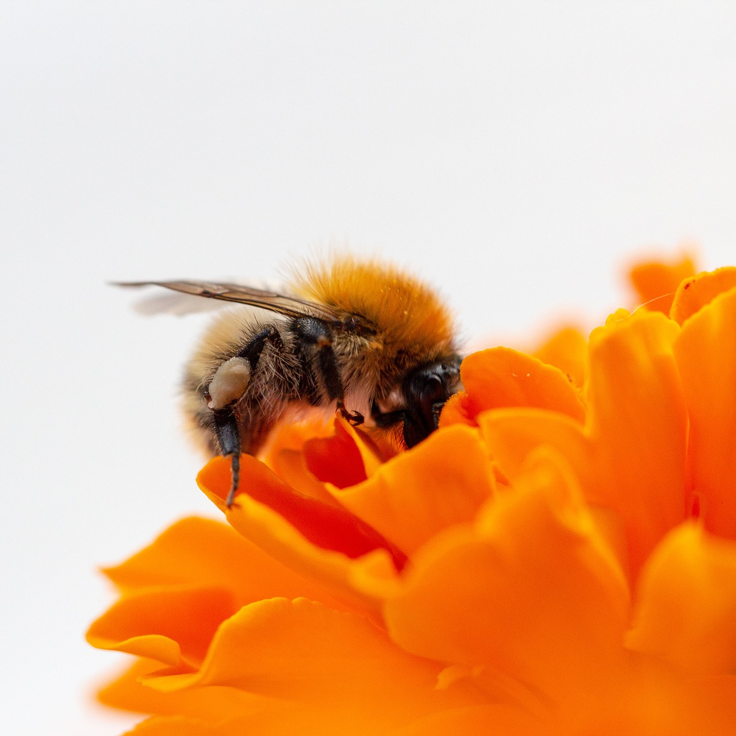
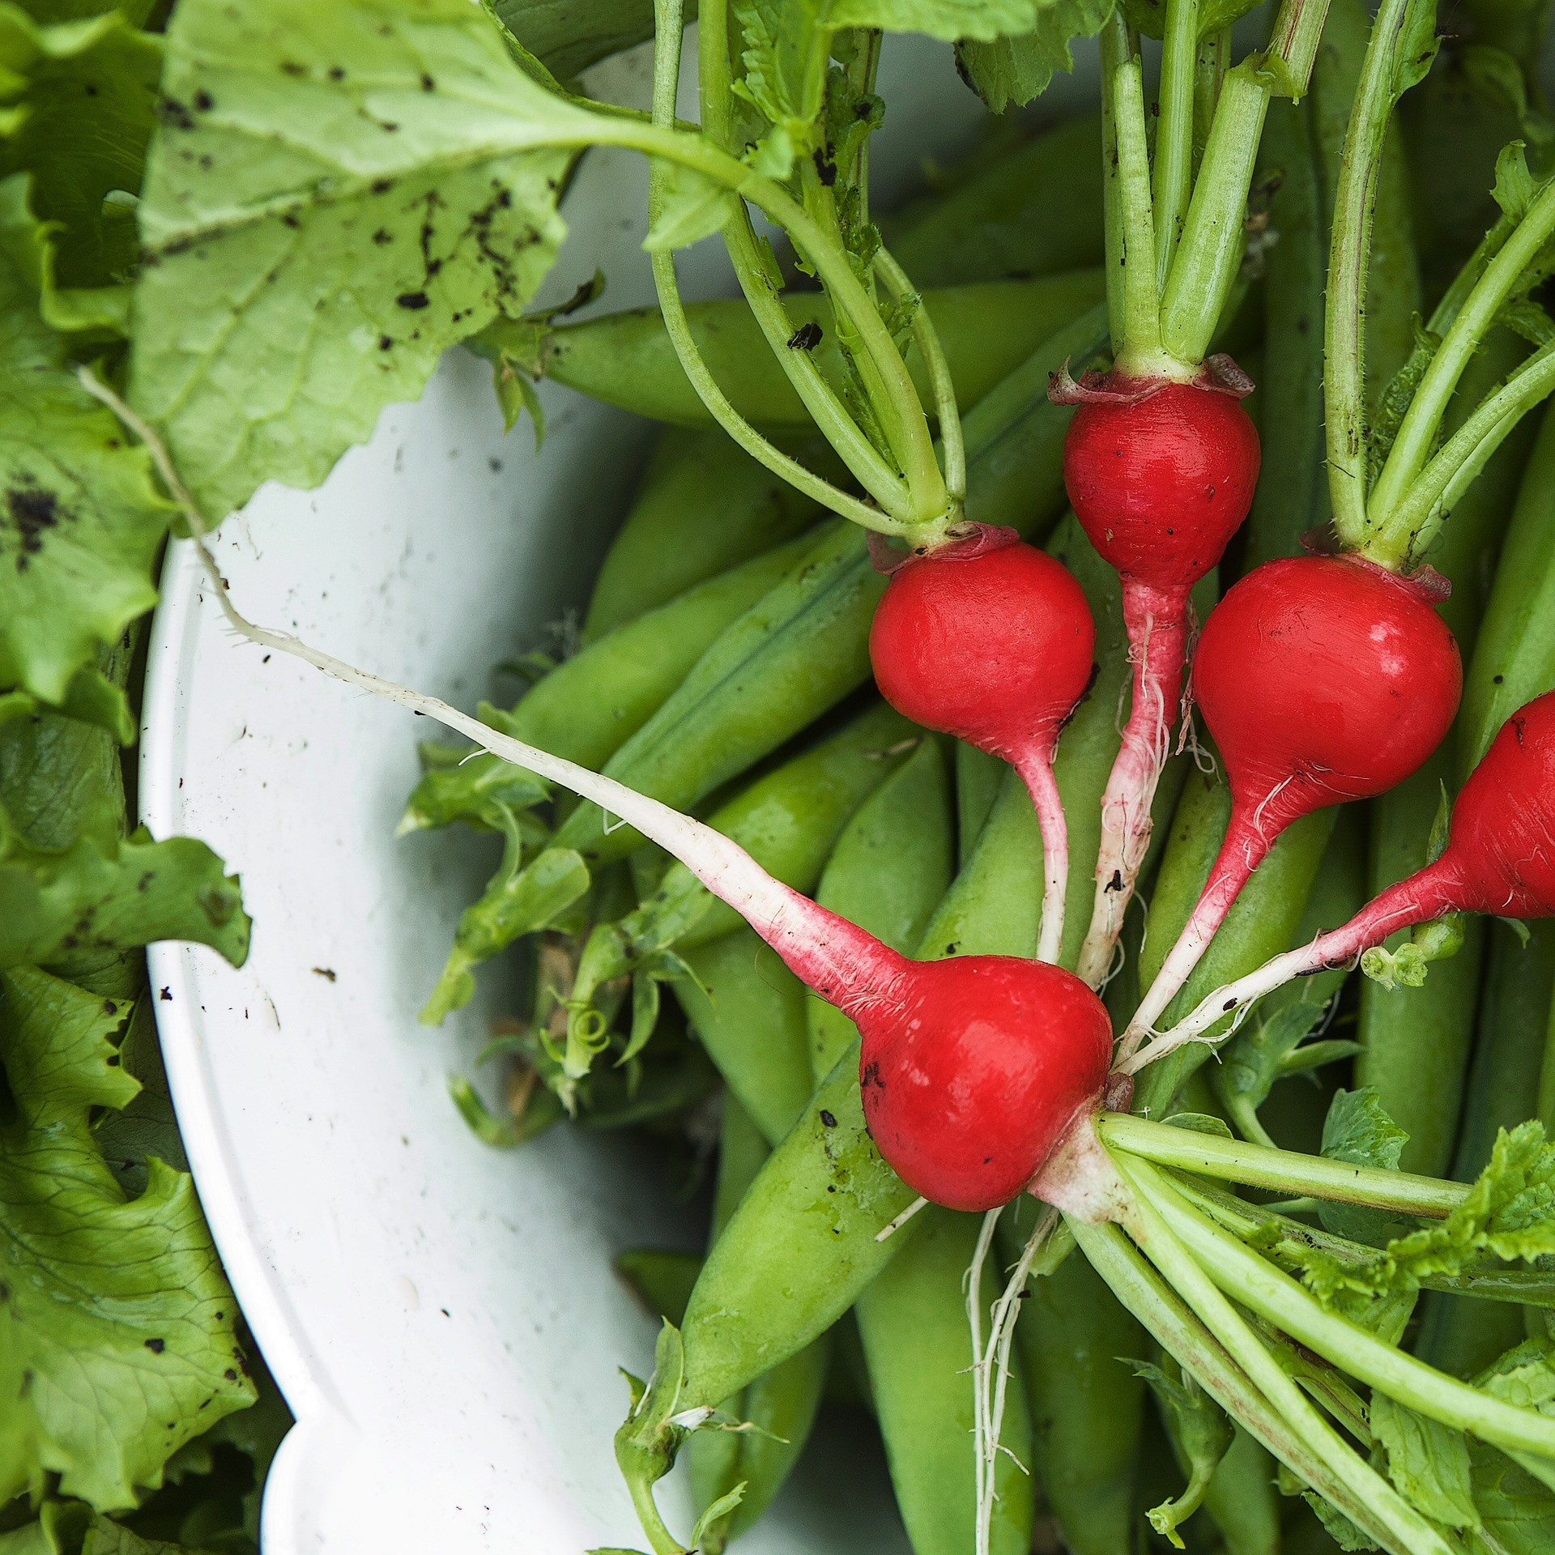
Where you can find us…
On the web
X (formerly Twitter)
Facebook
www.metromastergardeners.org
@TheRealDirt
@MetroMasterGardeners

